Slide 1


Calculus and applications
MTH10012
Week 12

Slide 2
Introduction
Week 11
Second order ODEs with constant coefficients
Functions of two variables
The method of cross-sections and simple surfaces
Week 12
Limits and continuity for functions of two variables
Partial derivatives
Small increments approximation
Chain rules for functions of two variables
Stationary points on a surface

Slide 3
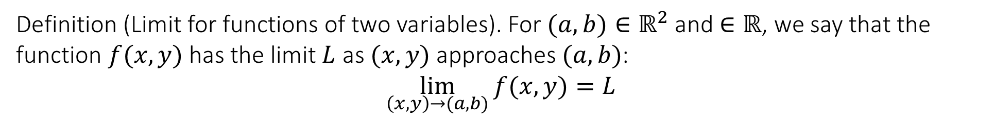
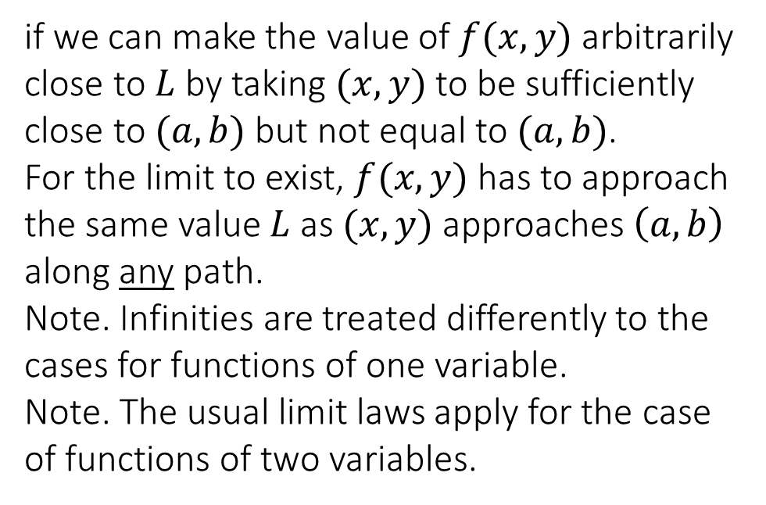
7.3 Limits and continuity for functions of two variables
Definition (Limit for functions of two variables). For $(a,b)∈ℝ^{2}$ and $∈ℝ$, we say that the function $f(x,y)$ has the limit $L$ as $(x,y)$ approaches $(a,b)$:
$$\lim_{\left(x,y\right)→(a,b)}{f(x,y)}=L$$
if we can make the value of $f(x,y)$ arbitrarily close to $L$ by taking $(x,y)$ to be sufficiently close to $(a,b)$ but not equal to $(a,b)$.
For the limit to exist, $f(x,y)$ has to approach the same value $L$ as $(x,y)$ approaches $\left(a,b\right)$ along any path.
Note. Infinities are treated differently to the cases for functions of one variable.
Note. The usual limit laws apply for the case of functions of two variables.

Slide 4
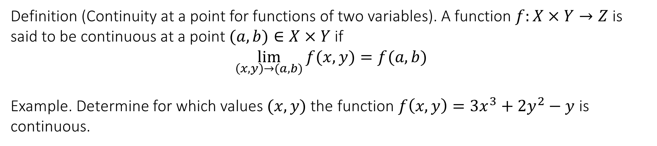
7.3 Limits and continuity for functions of two variables
Definition (Continuity at a point for functions of two variables). A function $f:X×Y→Z$ is said to be continuous at a point $(a,b)∈X×Y$ if
$$\lim_{\left(x,y\right)→(a,b)}{f(x,y)}=f(a,b)$$
Example. Determine for which values $(x,y)$ the function $f\left(x,y\right)=3x^{3}+2y^{2}−y$ is continuous.

Slide 5
7.3 Limits and continuity for functions of two variables
Example. Determine for which values $(x,y)$ the function $g\left(x,y\right)=\frac{x^{2}}{y}$ is continuous.

Slide 6
7.3 Limits and continuity for functions of two variables
Example. Evaluate the limit $\lim_{\left(x,y\right)→(1,0)}{\sin\left(\frac{π+y^{2}−xy}{2}\right)}$

Slide 7
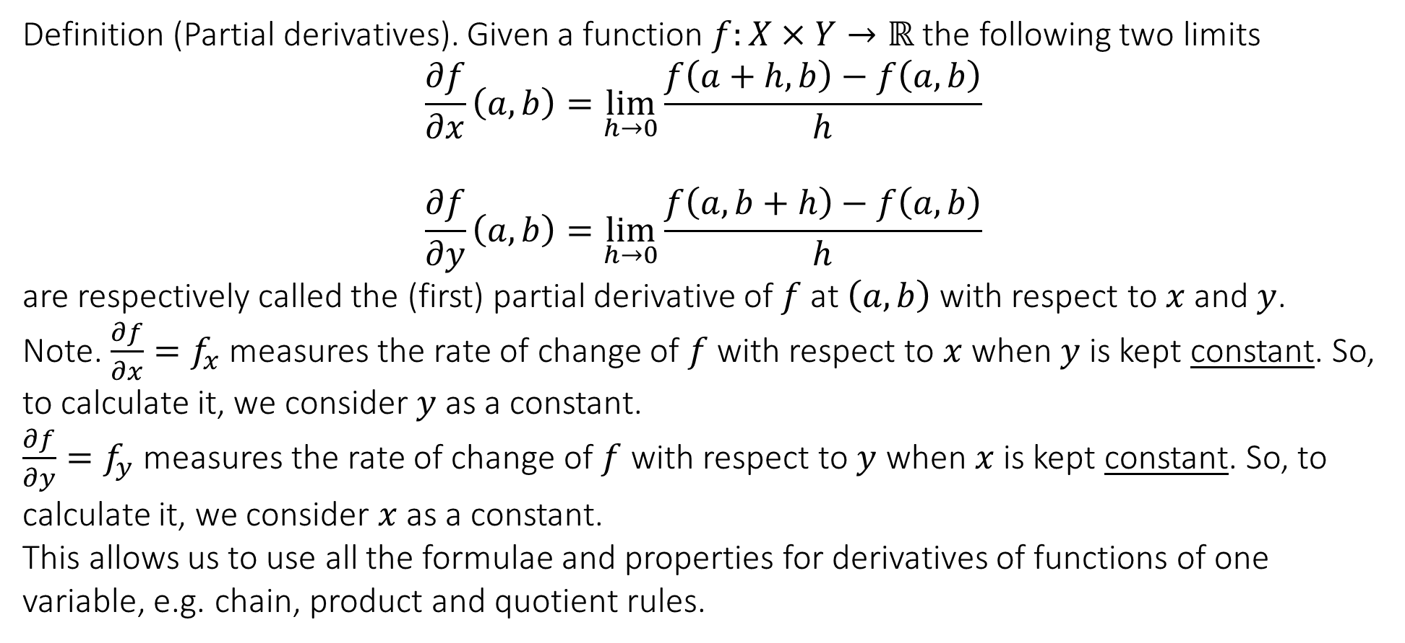
7.4 Partial derivatives
Definition (Partial derivatives). Given a function $f:X×Y→ℝ$ the following two limits
$$\frac{∂f}{∂x}\left(a,b\right)=\lim_{h→0}{\frac{f\left(a+h,b\right)−f\left(a,b\right)}{h}}$$
$$\frac{∂f}{∂y}\left(a,b\right)=\lim_{h→0}{\frac{f\left(a,b+h\right)−f\left(a,b\right)}{h}}$$
are respectively called the (first) partial derivative of $f$ at $\left(a,b\right)$ with respect to $x$ and $y$.
Note. $\frac{∂f}{∂x}=f_{x}$ measures the rate of change of $f$ with respect to $x$ when $y$ is kept constant. So, to calculate it, we consider $y$ as a constant.
$\frac{∂f}{∂y}=f_{y}$ measures the rate of change of $f$ with respect to $y$ when $x$ is kept constant. So, to calculate it, we consider $x$ as a constant.
This allows us to use all the formulae and properties for derivatives of functions of one variable, e.g. chain, product and quotient rules.

Slide 8
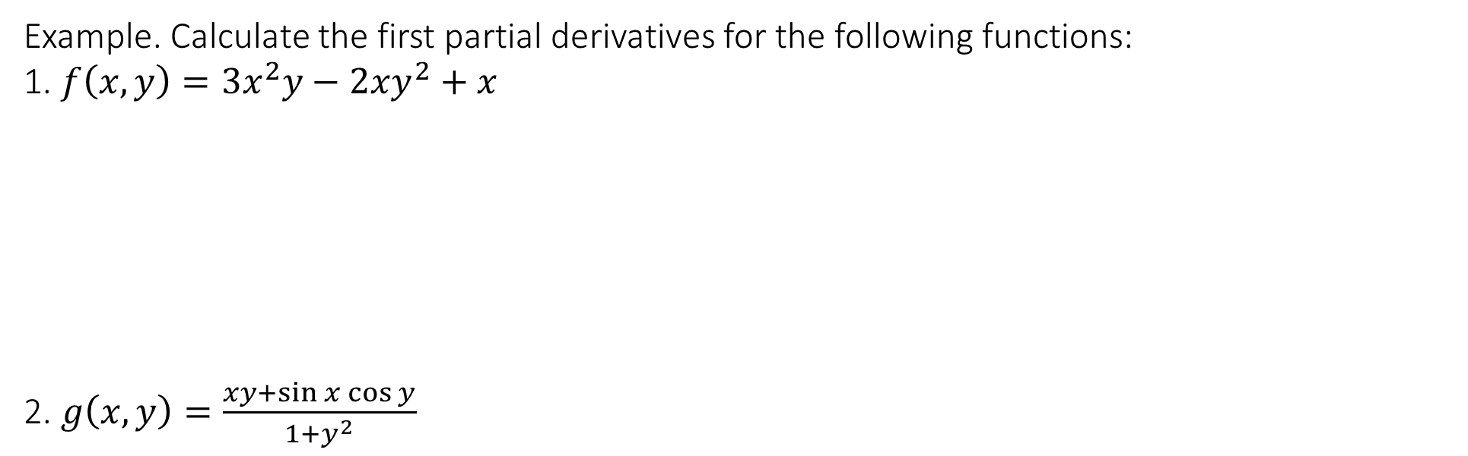
7.4 Partial derivatives
Example. Calculate the first partial derivatives for the following functions:
1. $f\left(x,y\right)=3x^{2}y−2xy^{2}+x$
2. $g\left(x,y\right)=\frac{xy+\sin{x}\cos{y}}{1+y^{2}}$

Slide 9
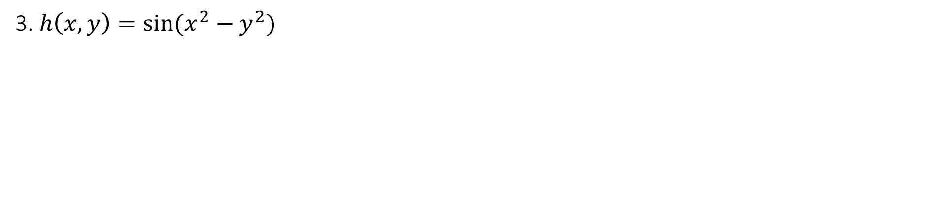
7.4 Partial derivatives
3. $h\left(x,y\right)=\sin{(x^{2}−y^{2})}$

Slide 10
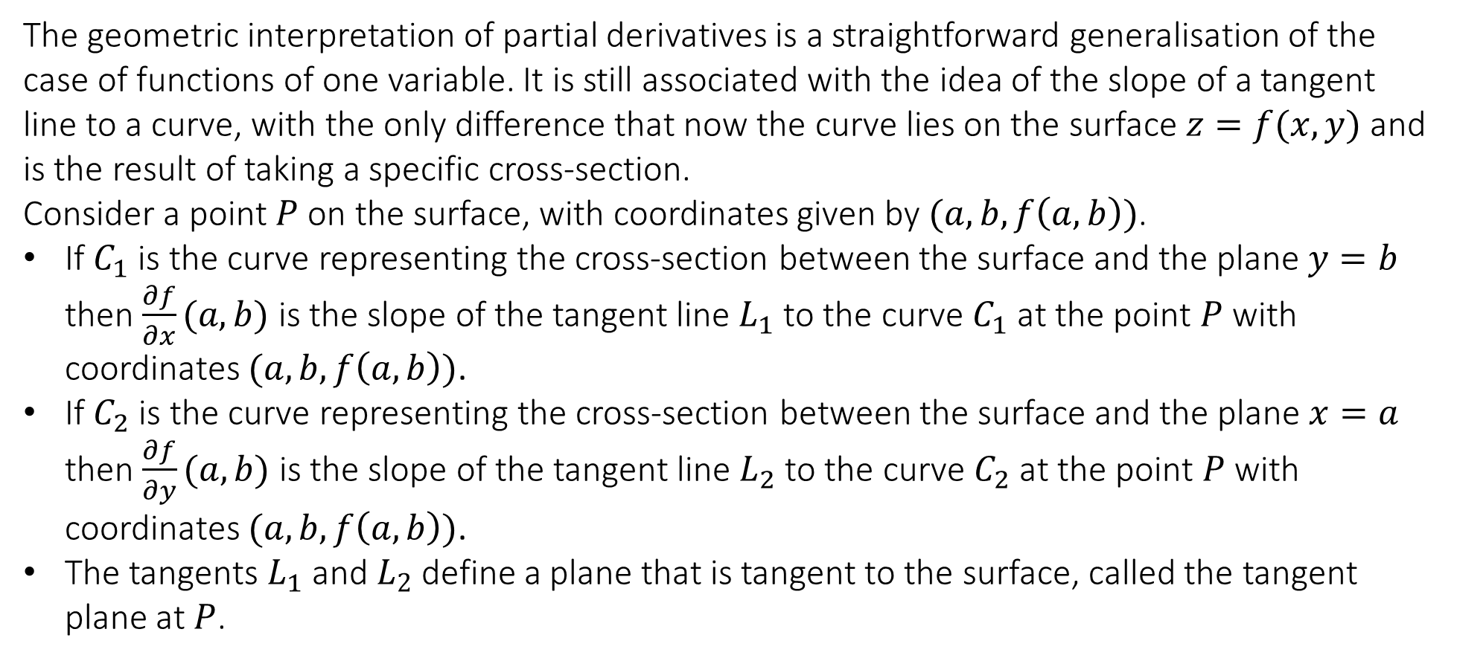
7.4 Partial derivatives
The geometric interpretation of partial derivatives is a straightforward generalisation of the case of functions of one variable. It is still associated with the idea of the slope of a tangent line to a curve, with the only difference that now the curve lies on the surface $z=f(x,y)$ and is the result of taking a specific cross-section.
Consider a point $P$ on the surface, with coordinates given by $(a,b,f\left(a,b\right))$.
If $C_{1}$ is the curve representing the cross-section between the surface and the plane $y=b$ then $\frac{∂f}{∂x}(a,b)$ is the slope of the tangent line $L_{1}$ to the curve $C_{1}$ at the point $P$ with coordinates $(a,b,f\left(a,b\right))$.
If $C_{2}$ is the curve representing the cross-section between the surface and the plane $x=a$ then $\frac{∂f}{∂y}(a,b)$ is the slope of the tangent line $L_{2}$ to the curve $C_{2}$ at the point $P$ with coordinates $(a,b,f\left(a,b\right))$.
The tangents $L_{1}$ and $L_{2}$ define a plane that is tangent to the surface, called the tangent plane at $P$.

Slide 11
7.4 Partial derivatives

Slide 12
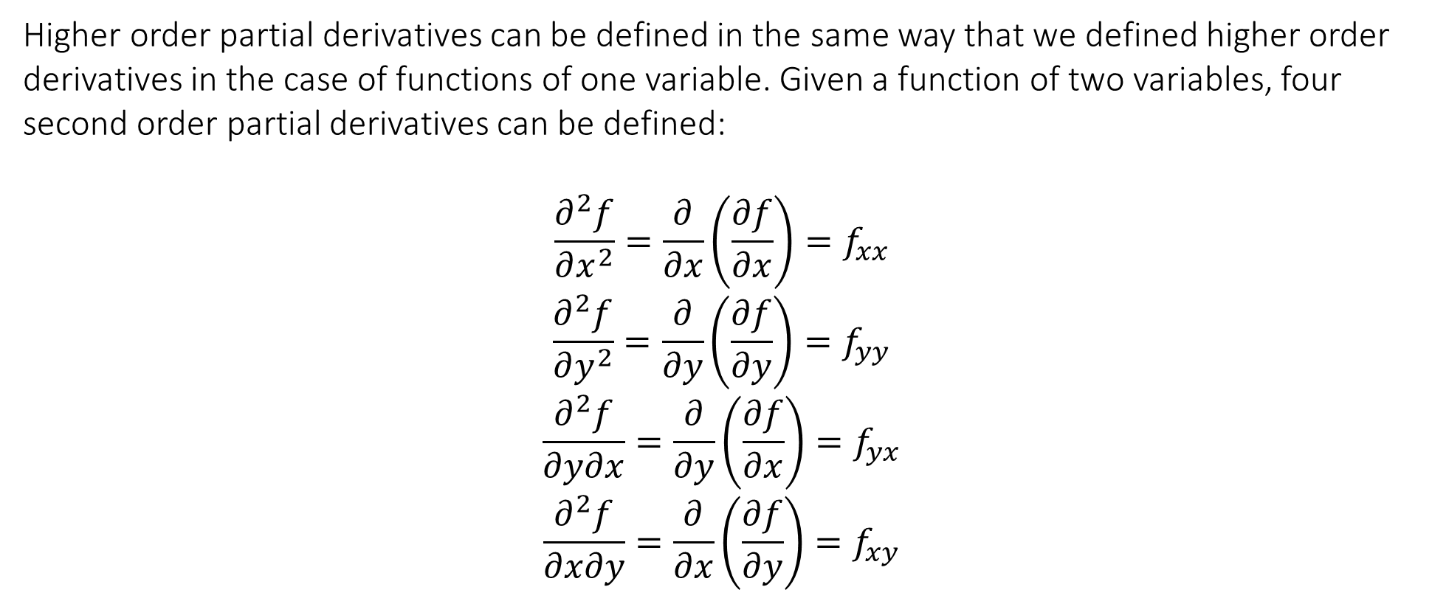
7.4 Partial derivatives
Higher order partial derivatives can be defined in the same way that we defined higher order derivatives in the case of functions of one variable. Given a function of two variables, four second order partial derivatives can be defined:
$$\frac{∂^{2}f}{∂x^{2}}=\frac{∂}{∂x}\left(\frac{∂f}{∂x}\right)=f_{xx}$$
$$\frac{∂^{2}f}{∂y^{2}}=\frac{∂}{∂y}\left(\frac{∂f}{∂y}\right)=f_{yy}$$
$$\frac{∂^{2}f}{∂y∂x}=\frac{∂}{∂y}\left(\frac{∂f}{∂x}\right)=f_{yx}$$
$$\frac{∂^{2}f}{∂x∂y}=\frac{∂}{∂x}\left(\frac{∂f}{∂y}\right)=f_{xy}$$
“Mixed” derivatives

Slide 13
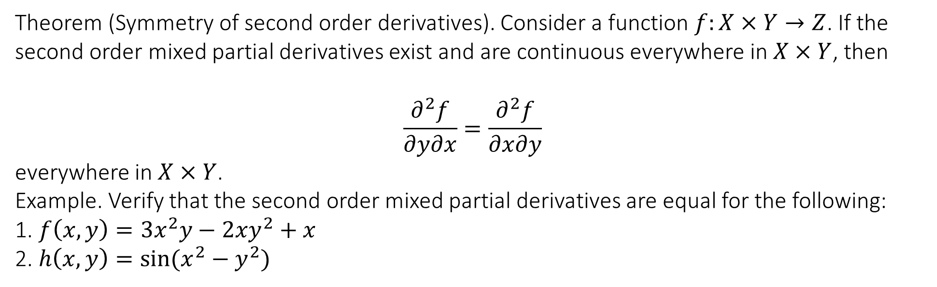
7.4 Partial derivatives
Theorem (Symmetry of second order derivatives). Consider a function $f:X×Y→Z$. If the second order mixed partial derivatives exist and are continuous everywhere in $X×Y$, then
$$\frac{∂^{2}f}{∂y∂x}=\frac{∂^{2}f}{∂x∂y}$$
everywhere in $X×Y$.
Example. Verify that the second order mixed partial derivatives are equal for the following:
1. $f\left(x,y\right)=3x^{2}y−2xy^{2}+x$
2. $h\left(x,y\right)=\sin{(x^{2}−y^{2})}$

Slide 14
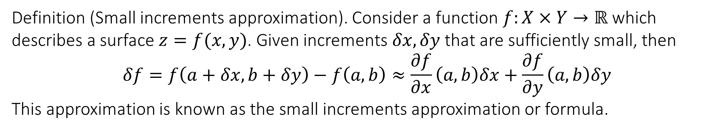
7.5 Small increments approximation
Definition (Small increments approximation). Consider a function $f:X×Y→ℝ$ which describes a surface $z=f(x,y)$. Given increments $δx,δy$ that are sufficiently small, then
$$δf=f\left(a+δx,b+δy\right)−f\left(a,b\right)≈\frac{∂f}{∂x}\left(a,b\right)δx+\frac{∂f}{∂y}\left(a,b\right)δy$$
This approximation is known as the small increments approximation or formula.

Slide 15
7.5 Small increments approximation
Example. Consider the function $f\left(x,y\right)=\exp{(xy^{3})}$. Calculate the approximate value of $f(x,y)$ at $x=1.1$ and $y=0.9$ using the value of $f$ at $x_{0}=1$ and $y_{0}=1$.

Slide 16
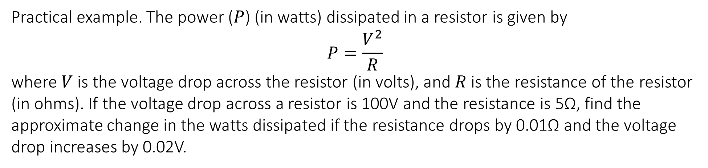
7.5 Small increments approximation
Practical example. The power ($P$) (in watts) dissipated in a resistor is given by
$$P=\frac{V^{2}}{R}$$
where $V$ is the voltage drop across the resistor (in volts), and $R$ is the resistance of the resistor (in ohms). If the voltage drop across a resistor is 100V and the resistance is 5Ω, find the approximate change in the watts dissipated if the resistance drops by 0.01Ω and the voltage drop increases by 0.02V.

Slide 17
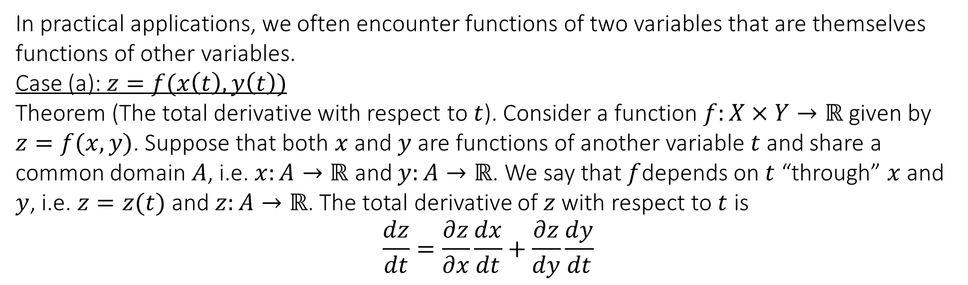
7.6 Two additional chain rules for functions of two variables
In practical applications, we often encounter functions of two variables that are themselves functions of other variables.
Case (a): $z=f(x\left(t\right),y\left(t\right))$
Theorem (The total derivative with respect to $t$). Consider a function $f:X×Y→ℝ$ given by $z=f(x,y)$. Suppose that both $x$ and $y$ are functions of another variable $t$ and share a common domain $A$, i.e. $x:A→ℝ$ and $y:A→ℝ$. We say that $f$depends on $t$ “through” $x$ and $y$, i.e. $z=z(t)$ and $z:A→ℝ$. The total derivative of $z$ with respect to $t$ is
$$\frac{dz}{dt}=\frac{∂z}{∂x}\frac{dx}{dt}+\frac{∂z}{dy}\frac{dy}{dt}$$

Slide 18
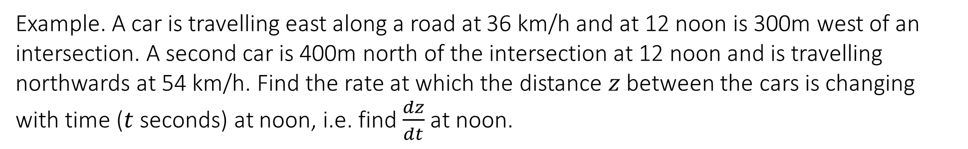
7.6 Two additional chain rules for functions of two variables
Example. A car is travelling east along a road at 36 km/h and at 12 noon is 300m west of an intersection. A second car is 400m north of the intersection at 12 noon and is travelling northwards at 54 km/h. Find the rate at which the distance $z$ between the cars is changing with time ($t$ seconds) at noon, i.e. find $\frac{dz}{dt}$ at noon.

Slide 19
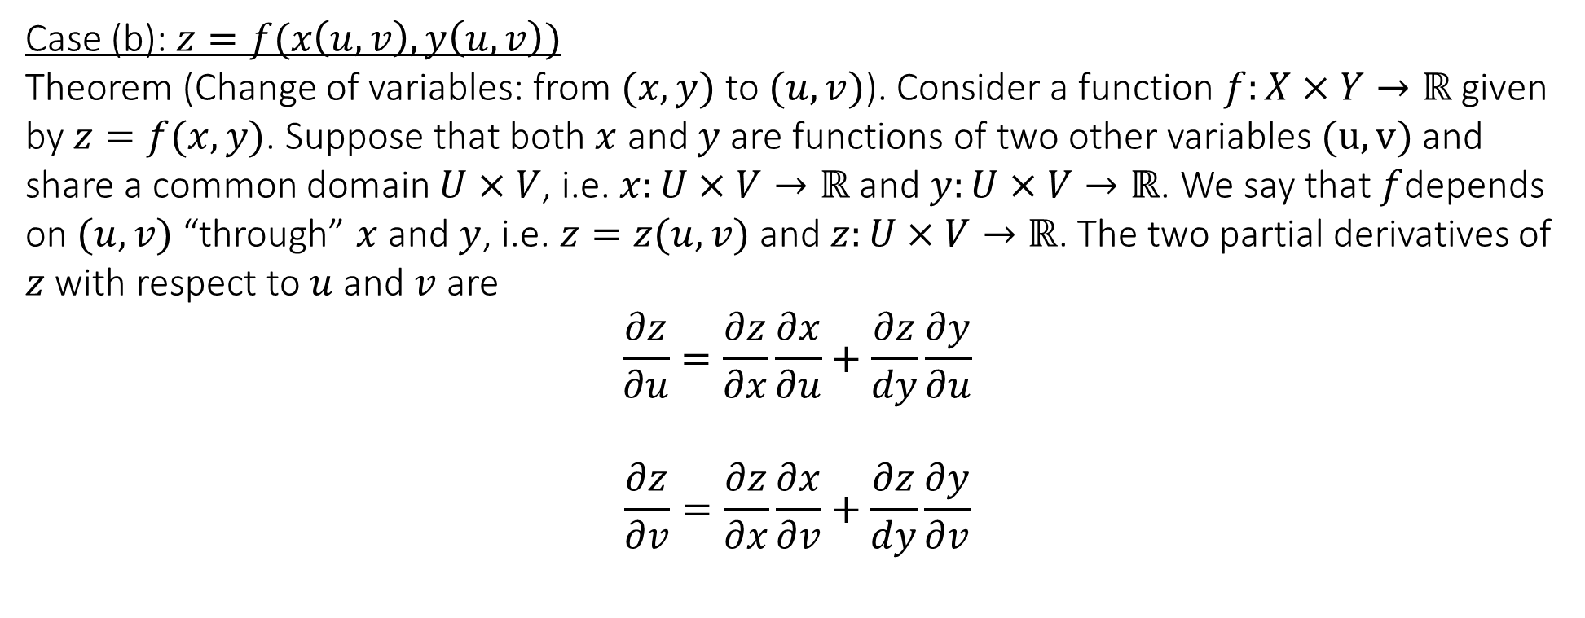
7.6 Two additional chain rules for functions of two variables
Case (b): $z=f(x\left(u,v\right),y\left(u,v\right))$
Theorem (Change of variables: from $(x,y)$ to $(u,v)$). Consider a function $f:X×Y→ℝ$ given by $z=f(x,y)$. Suppose that both $x$ and $y$ are functions of two other variables $(u,v)$ and share a common domain $U×V$, i.e. $x:U×V→ℝ$ and $y:U×V→ℝ$. We say that $f$depends on $(u,v)$ “through” $x$ and $y$, i.e. $z=z(u,v)$ and $z:U×V→ℝ$. The two partial derivatives of $z$ with respect to $u$ and $v$ are
$$\frac{∂z}{∂u}=\frac{∂z}{∂x}\frac{∂x}{∂u}+\frac{∂z}{dy}\frac{∂y}{∂u}$$
$$\frac{∂z}{∂v}=\frac{∂z}{∂x}\frac{∂x}{∂v}+\frac{∂z}{dy}\frac{∂y}{∂v}$$

Slide 20
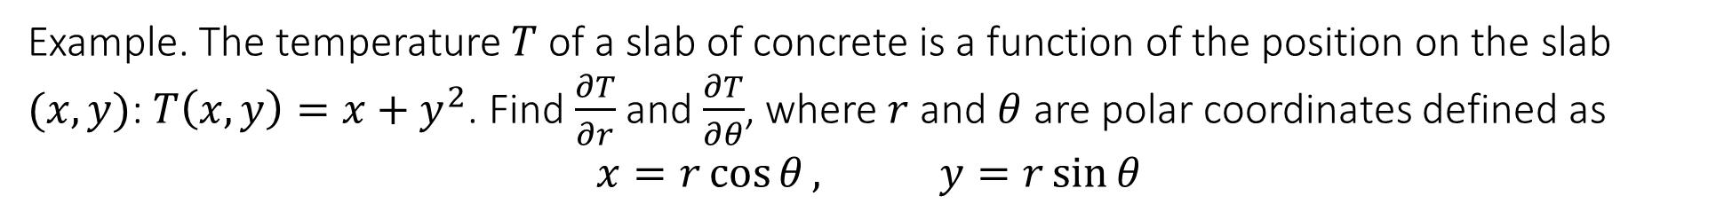
7.6 Two additional chain rules for functions of two variables
Example. The temperature $T$ of a slab of concrete is a function of the position on the slab $(x,y)$: $T\left(x,y\right)=x+y^{2}$. Find $\frac{∂T}{∂r}$ and $\frac{∂T}{∂θ}$, where $r$ and $θ$ are polar coordinates defined as
$$x=r\cos{θ}, y=r\sin{θ}$$

Slide 21
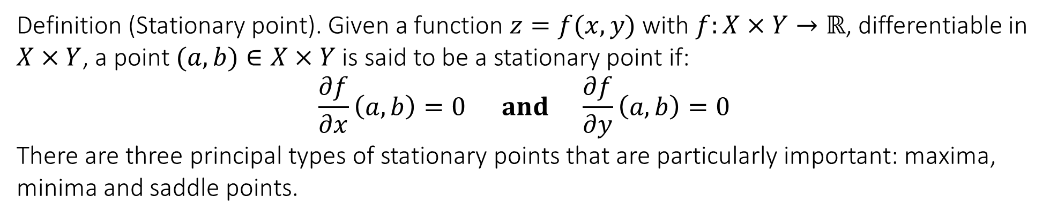
7.7 Stationary point of a surface
Definition (Stationary point). Given a function $z=f(x,y)$with $f:X×Y→ℝ$, differentiable in $X×Y$, a point $(a,b)∈X×Y$ is said to be a stationary point if:
$$\frac{∂f}{∂x}\left(a,b\right)=0 and \frac{∂f}{∂y}\left(a,b\right)=0$$
There are three principal types of stationary points that are particularly important: maxima, minima and saddle points.

Slide 22
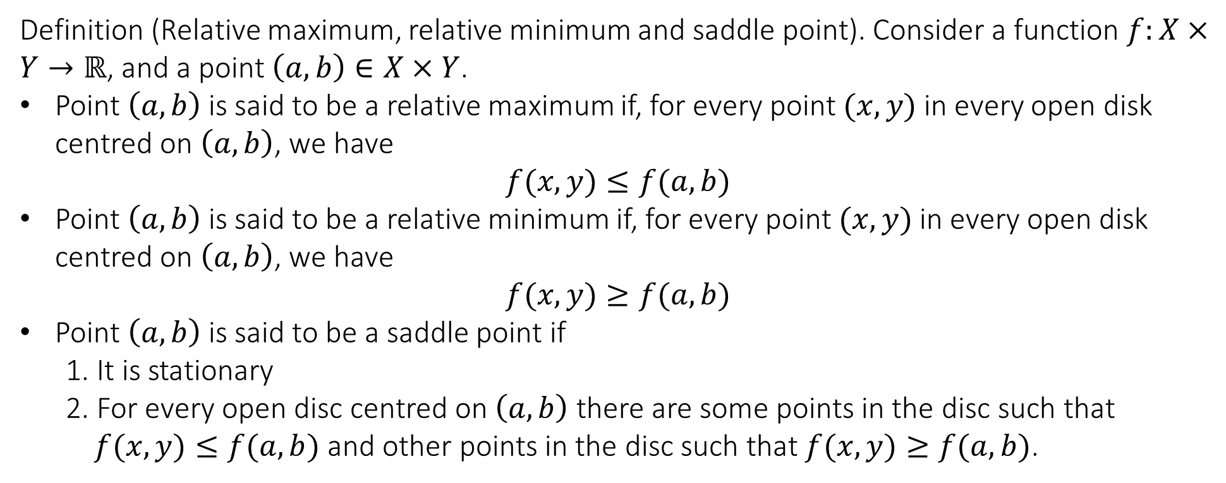
7.7 Stationary point of a surface
Definition (Relative maximum, relative minimum and saddle point). Consider a function $f:X×Y→ℝ$, and a point $\left(a,b\right)∈X×Y$.
Point $\left(a,b\right)$ is said to be a relative maximum if, for every point $(x,y)$ in every open disk centred on $\left(a,b\right)$, we have
$$f(x,y)≤f(a,b)$$
Point $\left(a,b\right)$ is said to be a relative minimum if, for every point $(x,y)$ in every open disk centred on $\left(a,b\right)$, we have
$$f(x,y)≥f(a,b)$$
Point $\left(a,b\right)$ is said to be a saddle point if
1. It is stationary
2. For every open disc centred on $\left(a,b\right)$ there are some points in the disc such that $f(x,y)≤f(a,b)$ and other points in the disc such that $f(x,y)≥f(a,b)$.

Slide 23
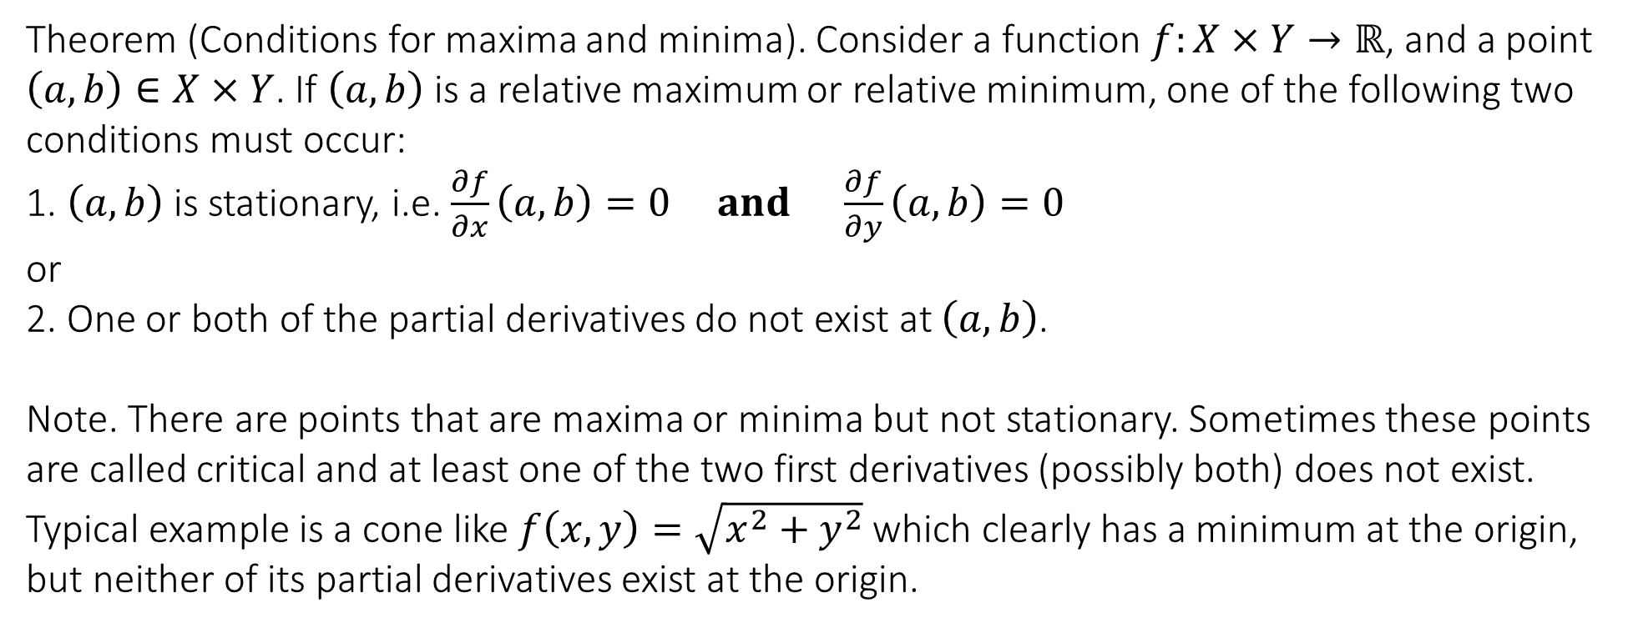
7.7 Stationary point of a surface
Theorem (Conditions for maxima and minima). Consider a function $f:X×Y→ℝ$, and a point $\left(a,b\right)∈X×Y$. If $\left(a,b\right)$ is a relative maximum or relative minimum, one of the following two conditions must occur:
1. $\left(a,b\right)$ is stationary, i.e. $\frac{∂f}{∂x}\left(a,b\right)=0 and \frac{∂f}{∂y}\left(a,b\right)=0$
or
2. One or both of the partial derivatives do not exist at $\left(a,b\right)$.
Note. There are points that are maxima or minima but not stationary. Sometimes these points are called critical and at least one of the two first derivatives (possibly both) does not exist.
Typical example is a cone like $f\left(x,y\right)=\sqrt{x^{2}+y^{2}}$ which clearly has a minimum at the origin, but neither of its partial derivatives exist at the origin.

Slide 24
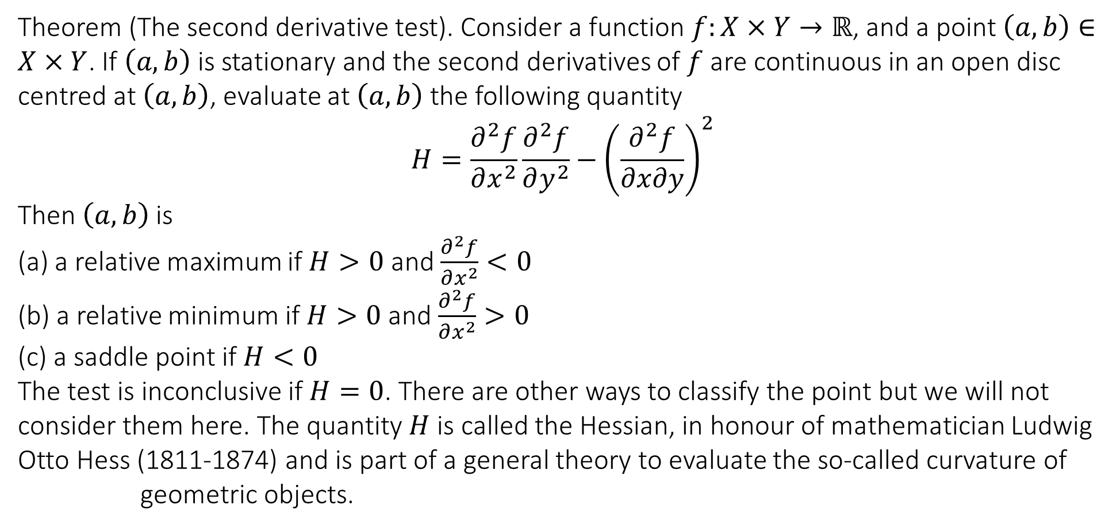
7.7 Stationary point of a surface
Theorem (The second derivative test). Consider a function $f:X×Y→ℝ$, and a point $\left(a,b\right)∈X×Y$. If $\left(a,b\right)$ is stationary and the second derivatives of $f$ are continuous in an open disc centred at $\left(a,b\right)$, evaluate at $\left(a,b\right)$ the following quantity
$$H=\frac{∂^{2}f}{∂x^{2}}\frac{∂^{2}f}{∂y^{2}}−{\left(\frac{∂^{2}f}{∂x∂y}\right)}^{2}$$
Then $\left(a,b\right)$ is
(a) a relative maximum if $H>0$ and $\frac{∂^{2}f}{∂x^{2}}<0$
(b) a relative minimum if $H>0$ and $\frac{∂^{2}f}{∂x^{2}}>0$
(c) a saddle point if $H<0$
The test is inconclusive if $H=0$. There are other ways to classify the point but we will not consider them here. The quantity $H$ is called the Hessian, in honour of mathematician Ludwig Otto Hess (1811-1874) and is part of a general theory to evaluate the so-called curvature of
geometric objects.

Slide 25
7.7 Stationary points of a surface
Example. Find the stationary points and their nature for the function $f\left(x,y\right)=x^{3}+x^{2}−y^{2}$

Slide 26
7.7 Stationary points of a surface
Example. Find the stationary points and their nature for the function
$f\left(x,y\right)=y^{2}−x^{2}y−\frac{1}{3}x^{3}$

Slide 27
7.7 Stationary points of a surface
Practical example. An open tank, which is a cuboid with sides and base of thin sheet material, must have a volume of 4 cubic metres. Find the dimensions that minimise the area of sheet material.

Slide 28


